Slide 1

FORVIA HELLA Internship Program 2022
Craiova, 2022

Slide 2

FORVIA HELLA Internship Program 2022
Choose one from the following four projects and send a Power Point Presentation with your solution. The project can be made physical or simulated
Add information like print screens or text with C code or pseudocode, comments/ documentation on code implementation, photos with hardware implementation/simulation, architectural details, or anything you consider relevant
Deadline to send the presentation: 2 days
This presentation is mandatory for the next step in Internship selection process >> Face to face interview

Slide 3
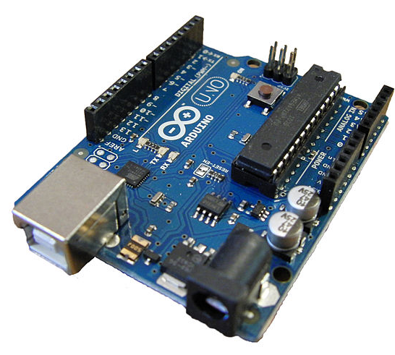
FORVIA HELLA Internship Program 2022
Projects proposals
Project 1 – Turn Signal ECU
TO DO:
Given the following requirements, please create a system using an Arduino Uno Board (HW and SW) which mimics the functionality of a “Turn Signal ECU”.
Inputs: 2 switches: turn signal lever switch and hazard lights switch. For the turn signal lever switch use a SPDT switch and for hazard lights switch use a SPST switch.
Outputs: 4 LEDs (simulating 2 front turn lights and 2 rear turn lights)
Description of the functionality:
1st position of the turn signal lever activates the Turn Left functionality, 2nd position of the turn signal lever activates the Turn Right functionality and the hazard lights switch activates the Hazard lights functionality.
Hazard functionality has the highest priority.
On time of any LED = 400ms , off time of any LED = 400ms

Slide 4
FORVIA HELLA Internship Program 2022
Projects proposals
Project 2 – Rear Wing ECU
TO DO:
Given the following requirements, please create a system using an Arduino Uno Board (HW and SW) which mimics the functionality of a “Rear Wing ECU”.
Inputs: serial communication (UART or SPI) for simulation the actual speed of the car, 1 switch (on/off switch).
Outputs: 2x LEDs (one to show the Rear Wing is in “Extended” position and one to show the Rear Wing is “Retracted” position)
Description of the functionality :
If the switch is in position “Switch off” the Rear Wing functionality is inactive (both LEDs are OFF)
Via serial communication, we will send the “actual” speed of the car.
If speed >= 100Km/h then the Rear Wing is in “Extended” position (the corresponding LED should be ON)
If speed < 50Km/h then the Rear Wing is in “Retracted” position (the corresponding LED should be ON)

Slide 5
FORVIA HELLA Internship Program 2022
Projects proposals
Project 3 – Network between 2 ECUs
TO DO:
Given the following requirements, please create a system using two Arduino Uno Boards (HW and SW) which mimics the “Communication Network between two ECUs”
Inputs: 1 switch
Outputs: 1 led
Description of the functionality :
1st Arduino board will read the state of the switch.
2nd Arduino board will control the LED.
A point-to-point connection between the “ECUs” must be created (Example: UART, SPI or I2C …).
The LED will mimic the state of the switch (Example: Switch closed → LED = on, Switch opened → LED = off).
A “failsafe” mode must be implemented in case the communication between the bords is defective (Example: communication interrupted → LED blinks).

Slide 6
FORVIA HELLA Internship Program 2022
Projects proposals
Project 4
“CookiesForYou” is a company that owns cookie stores in Craiova, located along the main road Calea Bucureşti. The cookie stores are numbered from 1 to n in the order of their location on Calea Bucureşti.
The positions of the cookie stores are known, being specified by the distances d1, d2, …, dn (di represents the distance from the headquarters to the store i). The headquarters of “CookiesForYou” is located at the entrance to the city, on Calea Bucureşti.
In k of these cookie stores, the company wants to build warehouses for cookies, which will supply the respective store and all the neighboring cookie stores. Each cookie store will be supplied by the nearest warehouse.
The transportation cost for a given warehouse arrangement will be equal to the distances from each cookie store to the warehouse from which it is supplied.
TO DO:
Please write a program to determine all the cookie stores that should build a warehouse so that the transportation cost is minimal.
Input
The input file cofetaria.in contains on the first line two positive integer numbers separated by space (n and k), representing the number of cookie stores and respectively the number of warehouses to be built. On the next n lines are written n positive integer numbers d1, d2, …, dn, (one number per line) representing the distances from the “CookiesForYou” headquarters to all the n stores.
Output
The output file cofetaria.out will contain on the first line the minimum possible transportation cost. On the next k lines are written the cookie stores where the warehouses will be built to obtain the minimum cost, one store per line.
Example
Constraints & Additional Notes
1 ≤ n ≤ 40
1 ≤ k ≤ 30
k ≤ n
0 < d1 < d2 < … < dn ≤ 30000
If there are several solutions, you can determine any of them.
cofetaria.in | cofetaria.out | Description
6 3 5 6 12 19 20 27 | 8 2 4 6 | Warehouse 1 will be built in store 2 and will supply the stores 1, 2, 3. (Cost: 1+0+6=7) Warehouse 2 1 will be built in store 4 and will supply stores 4, 5. (Cost: 0+1=1) Warehouse 3 will be built in store 6 and will supply store 6. (Cost: 0)

